Slide 1



Introduction to Git and GitHub
R. Burke Squires
June 2025

Slide 2
Outline
Introduction to version (source) control
History and fundamental concepts behind version (source) control
Centralized vs. distributed version control
Introduction to Git
What is Git? Basic Git concepts and architecture
Git workflows: Creating a new repo (adding, committing code)
HEAD
Git commands (checking out code)
Master vs branch concept
Creating a branch/switching between branches
Merging branches and resolving conflicts
Introduction to GitHub
What is GitHub? Basic GitHub concepts
GitHub in practice: Distributed version control
Cloning a remote repo
Fetching/Pushing to a remote repo
Collaborating using Git and GitHub

Slide 3
“Normal” Version Control
“New exciting paper – final.docx”
“New exciting paper – second final.docx”
“New exciting paper – really final.docx”
“New exciting paper – ABC-final-2.docx”
“New exciting paper – 20240627-final.docx”
“New exciting paper – 20240627-final-final.docx”
“New exciting paper – 20240627-final-ABC.docx”
“New exciting paper – final.docx”

Slide 4
What Is A ‘Version Control?’
A way to manage files and directories
Track changes over time
Recall previous versions
‘Source control’ is a subset of a VCS
An apt description is that version control is like an “unlimited undo”

Slide 5


Some History Of Source Control…
(1972) Source Code Control System (SCCS)
Closed source, part of UNIX
(1982) Revision Control System(RCS)
Open source
(1986) Concurrent Versions System (CVS)
Open source
(2000) Apache Subversion (SVN)

Slide 6

…more history
(2000) BitKeeper SCM
Closed source, proprietary, used with
Source code management of Linux kernel
Free until 2005
Distributed version control

Slide 7
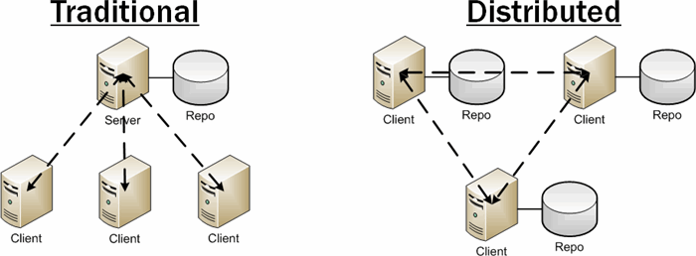
Distributed Version Control
No central server
Every developer is a client, the server and the repository
Source: http://bit.ly/1SH4E23

Slide 8
What is git?

Slide 9

What is git?
Created by Linus Torvalds, April 2005
Replacement for bitkeeper to manage Linux kernel changes
A command line version control program
Uses checksums to ensure data integrity
Distributed version control (like bitkeeper)
Cross-platform (including windows!)
Open source, free

Slide 10
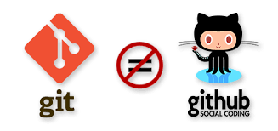

Slide 11
Popularity
Year | Git | SVN (Subversion) | Mercurial | CVS | Perforce | Other (VSS, ClearCase, etc.)
2000 | 0% | ~5% | 0% | ~60% | ~10% | ~25%
2005 | 0% | ~15% | 0% | ~50% | ~15% | ~20%
2010 | ~20% | ~35% | ~10% | ~20% | ~10% | ~5%
2015 | ~65% | ~20% | ~5% | ~5% | ~5% | ~0%
2020 | ~85% | ~10% | ~2% | ~1% | ~2% | ~0%
2025 | 93.90% | 5.20% | 1.10% | <1% | <1% | <1%
Here is a table summarizing the popularity of major version control systems (VCS) from 2000 to 2025, based on available survey data, market trends, and historical context. The percentages represent approximate developer usage or market share during each period.
Notes:
Here is a **table summarizing the popularity of major version control systems (VCS) from 2000 to 2025**, based on available survey data, market trends, and historical context. The percentages represent approximate developer usage or market share during each period.
| Year | Git | SVN (Subversion) | Mercurial | CVS | Perforce | Other (VSS, ClearCase, etc.) |
|------|-----|------------------|-----------|-----|----------|------------------------------|
| 2000 | 0% | ~5% | 0% | ~60%| ~10% | ~25% |
| 2005 | 0% | ~15% | 0% | ~50%| ~15% | ~20% |
| 2010 | ~20%| ~35% | ~10% | ~20%| ~10% | ~5% |
| 2015 | ~65%| ~20% | ~5% | ~5% | ~5% | ~0% |
| 2020 | ~85%| ~10% | ~2% | ~1% | ~2% | ~0% |
| 2025 | 93.9%| 5.2% | 1.1% | <1% | <1% | <1% |
**Key notes:**
- **Git** was created in 2005 and quickly rose to dominance, especially after the rise of GitHub in the early 2010s[1][2].
- **SVN (Subversion)**, released in 2000, was the leading centralized VCS throughout the 2000s, but its share has steadily declined[3][4].
- **Mercurial** was released in 2005 and enjoyed moderate popularity, but never matched Git’s growth[2].
- **CVS** was the standard in the late 1990s and early 2000s but is now rarely used[3].
- **Perforce** and other enterprise systems (like Visual SourceSafe, ClearCase) were more common in the early 2000s but have become niche[3].
- By **2025**, **Git** is overwhelmingly dominant, with over 93% adoption among developers, while SVN and Mercurial have small but persistent user bases[1][5].
These numbers are approximate and based on a synthesis of developer surveys, market reports, and historical adoption trends[1][5][4].
Sources
[1] RhodeCode › Blog: Version Control Systems Popularity in 2025 https://rhodecode.com/blog/156/version-control-systems-popularity-in-2025
[2] Beyond Git: The other version control systems developers use https://stackoverflow.blog/2023/01/09/beyond-git-the-other-version-control-systems-developers-use/
[3] Comparison of version-control software - Wikipedia https://en.wikipedia.org/wiki/Comparison_of_version-control_software
[4] Top 10+ Version Control Tools in 2025 - Research AIMultiple https://research.aimultiple.com/version-control-tools/
[5] Version Control Systems Statistics 2025 - LLCBuddy https://llcbuddy.com/data/version-control-systems-statistics/
[6] Version Control Systems Market Size & Growth Report 2033 https://www.imarcgroup.com/version-control-systems-market
[7] The History and Influence of SCCS on Modern Version Control ... https://machaddr.substack.com/p/the-history-and-influence-of-sccs
[8] Version Control Systems Market - Forecast(2025 - IndustryARC https://www.industryarc.com/Research/Version-Control-Systems-Market-Research-500852
[9] SCCS, RCS, CVS, Subversion, Git, & Mercurial : r/programming https://www.reddit.com/r/programming/comments/e4k8yi/the_evolution_of_version_control_system_vcs/
[10] Version Control Systems Market Size, Share, Trends, Revenue ... https://www.marketsandmarkets.com/Market-Reports/version-control-system-market-53493826.html

Slide 12
Git Distributed Version Control
“If you’re not distributed, you’re not worth using.” – Linus Torvalds
No need to connect to central server
Can work without internet connection
No single failure point
Developers can work independently and merge their work later
Every copy of a git repository can serve either as the server or as a client (and has complete history!)
Git tracks changes, not versions
Bunch of little change sets floating around

Slide 13

Is Git For Me?
People primarily working with source code
Anyone wanting to track edits (especially changes to text files)
Review history of changes
Anyone wanting to share, merge changes
Anyone not afraid of
Command line tools

Slide 14
Most popular languages used with Git
HTML
CSS
Javascript
Python
R
ASP
Scala
Shell scripts
PHP
Ruby
Ruby on Rails
Perl
Java
C
C++
C#
Objective C
Haskell
CoffeeScript
ActionScript
Not as useful for image, movies,
music…and files that must be
interpreted (.pdf, .psd, etc.)

Slide 15
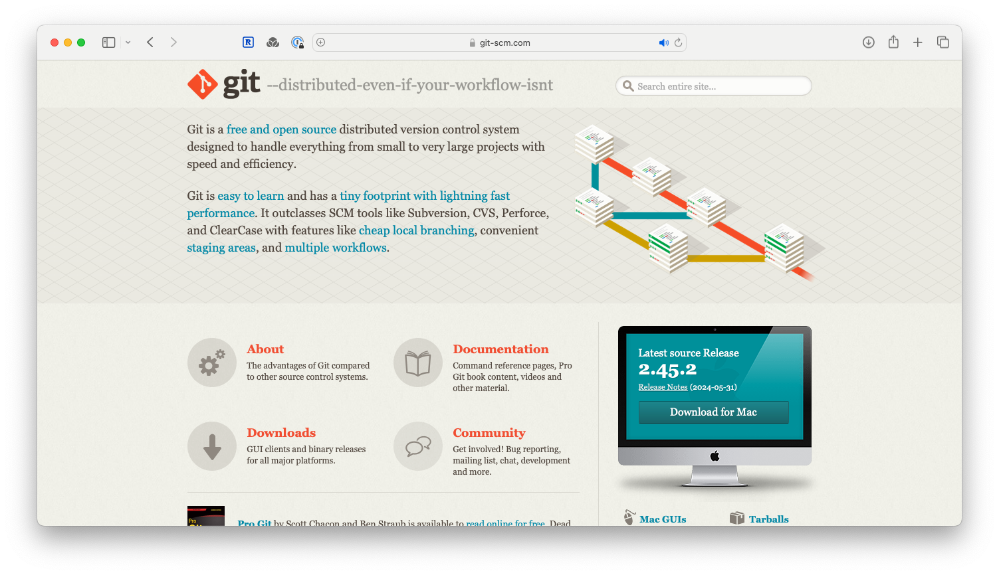
How Do I Get It?

Slide 16
Git Install Tip
Much better to set up on a per-user basis (instead of a global, system-wide install)

Slide 17
What Is A Repository?
“repo” = repository
usually used to organize a single project
repos can contain folders and files, images, videos, spreadsheets, and data sets – anything your project needs

Slide 18
Two-tree architecture
other VCSs
Repository
checkout
commit
working

Slide 19
Git uses a three-tree architecture
Repository
commit
Staging index
checkout
add
working

Slide 20
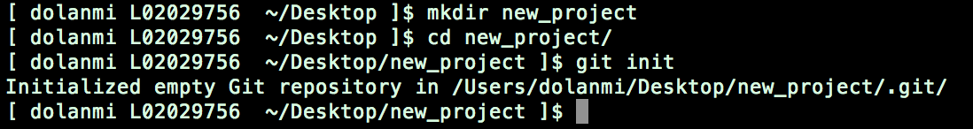
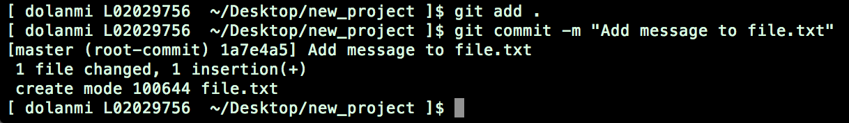
A simple Git workflow
Initialize a new project in a directory:
git init
2. Add a file using a text editor to the directory
3. Add every change that has been made to the directory:
git add .
Commit the change to the repo:
git commit –m “important message here”
.

Slide 21
After initializing a new git repo…
Repository
3. Commit changes with
a message
2. Add changes
1. Make changes
commit
Staging index
add
working

Slide 22
A Note About Commit Messages
Tell what it does (present tense)
Single line summary followed by blank space followed by more complete description
Keep lines to <= 72 characters
Ticket or bug number helps

Slide 23
Good And Bad Examples
Bad: “Typo fix”
Good: “Add missing / in CSS section”
Bad: “Updates the table. We’ll discuss next
Monday with Project Manager.”

Slide 24
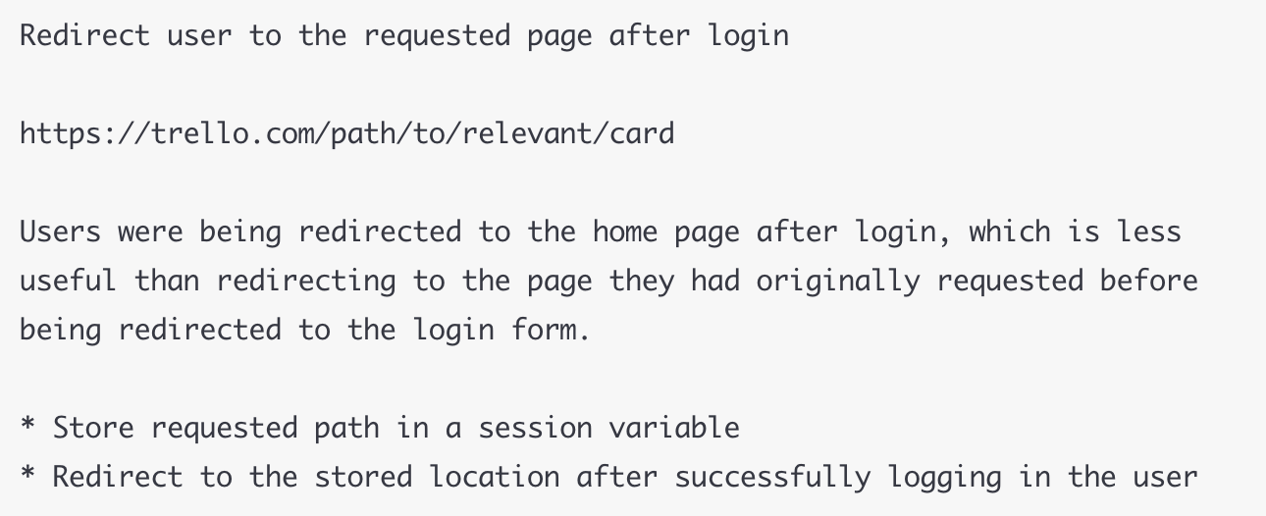
Bad: git commit -m "Fix login bug”
Good: git commit -m

Slide 25
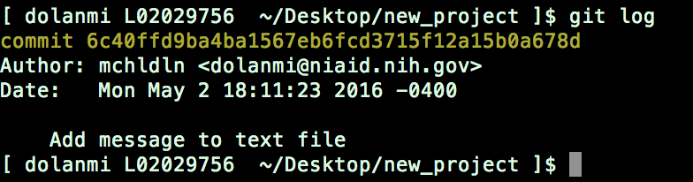
How To I See What Was Done?
git log

Slide 26
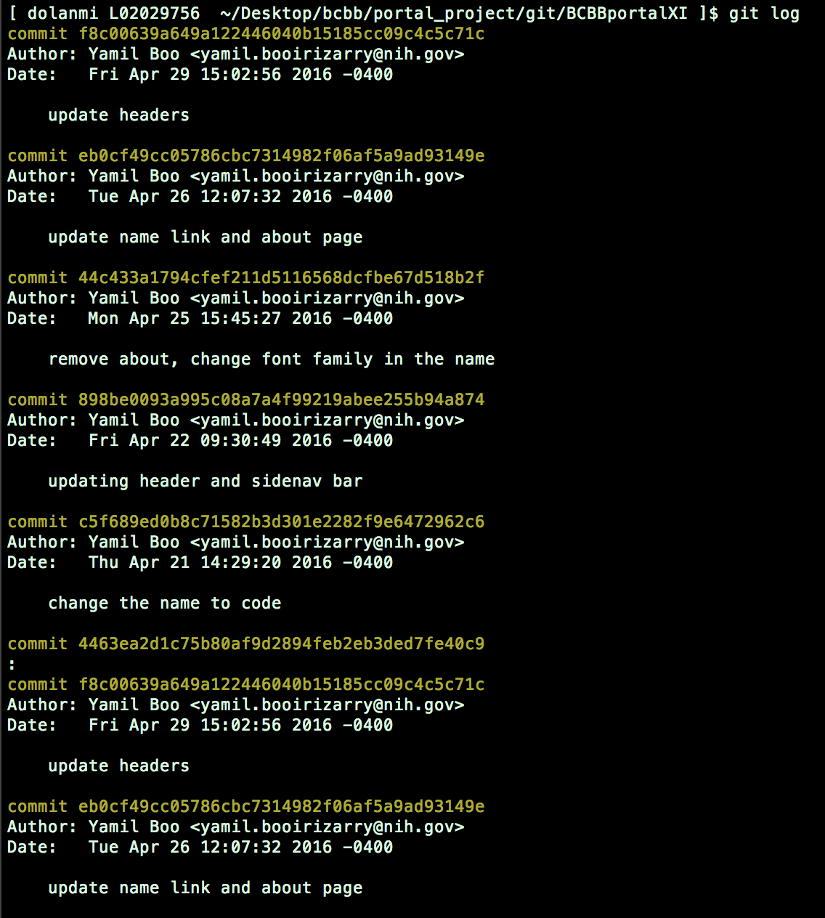
“SHAs”
Checksums
generated by
SHA1
encryption
algorithm
Notes:
One can log in in the morning and see what has been done and by who.

Slide 27

The HEAD Pointer
points to a specific commit in repo
as new commits are made, the pointer changes
HEAD always points to the “tip” of the
currently checked-out branch in the repo
(not the working directory or staging index)
last state of repo (what was checked out initially)
HEAD points to parent of next commit (where writing the next commit
takes place)

Slide 28
Last commit
Parent of
Parent of
Parent of
master
Y4f7uiPRRo…
Pu87rRi4DD..
Qs2o0k64ja…
i7Ewd37kL9…
HEAD
branch
9i5Tyh67dg..
oe48Hr3Gh9..
d3Ui94Hje4...
Notes:
Cat HEAD file in .git dir to see where HEAD is currently pointing.

Slide 29
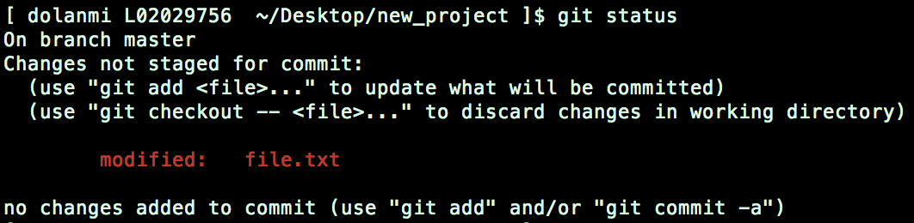
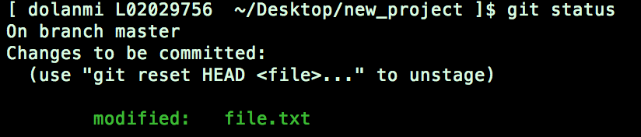
Which files were changed and where do they sit in the three tree?
git status – allows one to see where files are in the three tree scheme
Repository
commit
Staging index
add
working

Slide 30
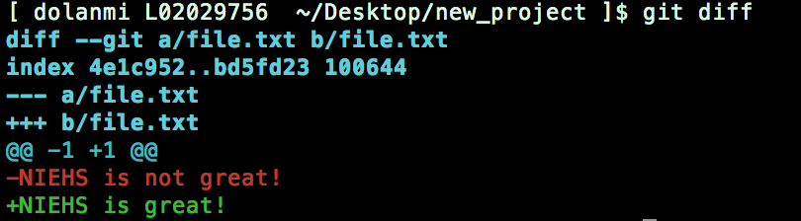
What changed in working directory?
git diff – compares changes to files between repo and working directory
Repository
Line numbers in file
Removed
Added
commit
Staging index
Note: git diff --staged - compares staging index to repo
Note: git diff filename can be used as well
add
working

Slide 31
Deleting files from the repo
Repository
git rm filename.txt
moves deleted file change to staging
area
It is not enough to delete the file in
your working directory. You must
commit the change.
commit
Staging index
add
working

Slide 32
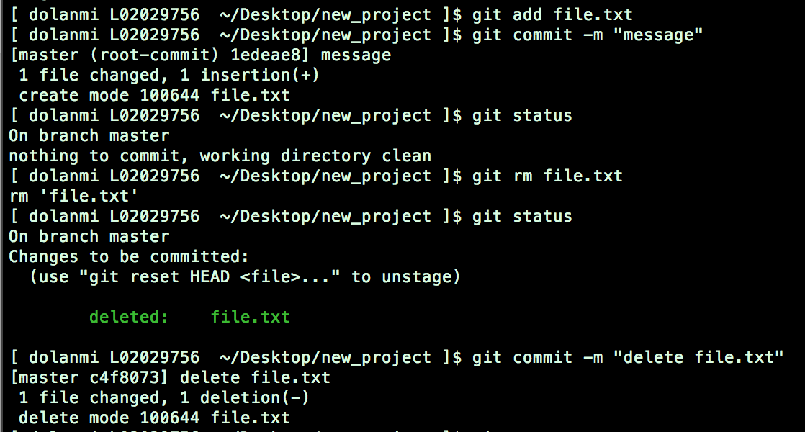
Deleting Files From The Repo

Slide 33
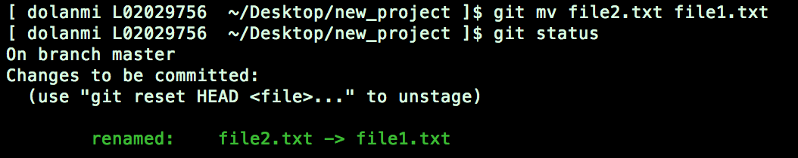
Moving (renaming) files
git mv filename1.txt filename2.txt
Repository
commit
Staging index
Note: File file1.txt was committed to repo earlier.
add
working

Slide 34
Good News!
git init
git status
git log
git add
git commit
git diff
git rm
git mv
75% of the time you’ll be using
only these commands

Slide 35
What If I Want To Undo Changes Made To Working Directory?
Repository
git checkout something
(where “something” is a file or an entire branch)
git checkout will grab the
file from the repo
Example: git checkout -- file1.txt
(“checkout file ‘file1.txt’ from the current branch”)
Staging index
checkout
working

Slide 36
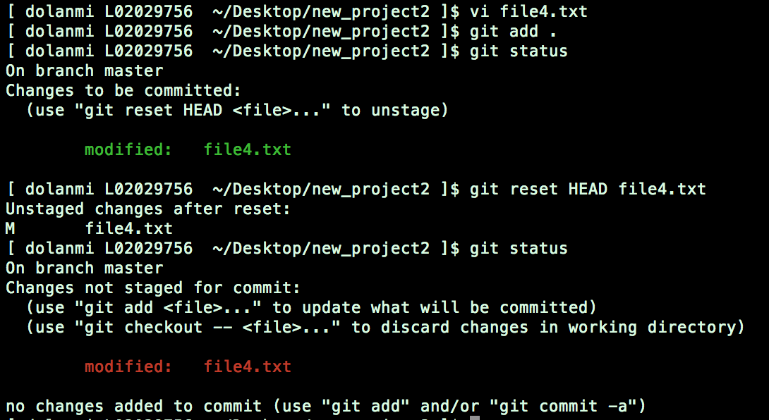
What If I Want To Undo Changes Added To Staging Area?
git reset HEAD filename.txt
Repository
commit
Staging index
add
working

Slide 37
What If I Want To Undo Changes Committed To The Repo?
git commit --amend -m “message”
allows one to amend a change to the last
commit
anything in staging area will be amended
to the last commit
Repository
commit
Staging index
add
working

Slide 38
Note: To undo changes to older commits, make a new commit
HEAD
Parent of
Parent of
Parent of
master
Y4f7uiPRRo…
Pu87rRi4DD..
Qs2o0k64ja…
i7Ewd37kL9…
Added ‘apple’ Added ‘plum’ Added ‘apple’
Notes:
Cat HEAD file in .git dir to see where HEAD is currently pointing.

Slide 39
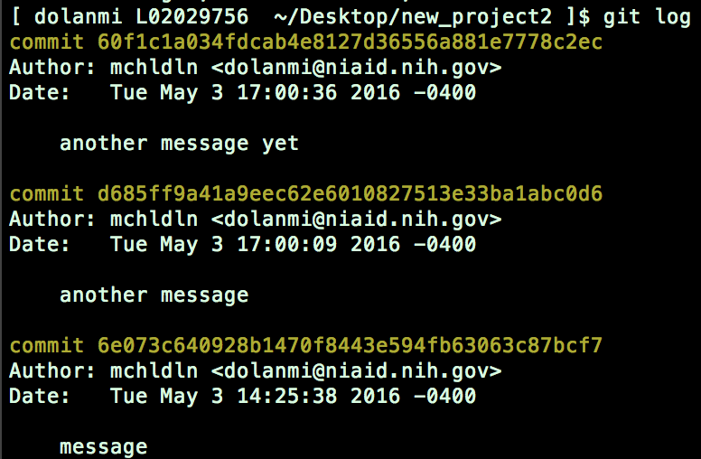
Obtain Older Versions
Repository
commit
Staging index
add
working
git checkout 6e073c640928b --filename.txt
Note: Checking out older commits places them into the staging area

Slide 40
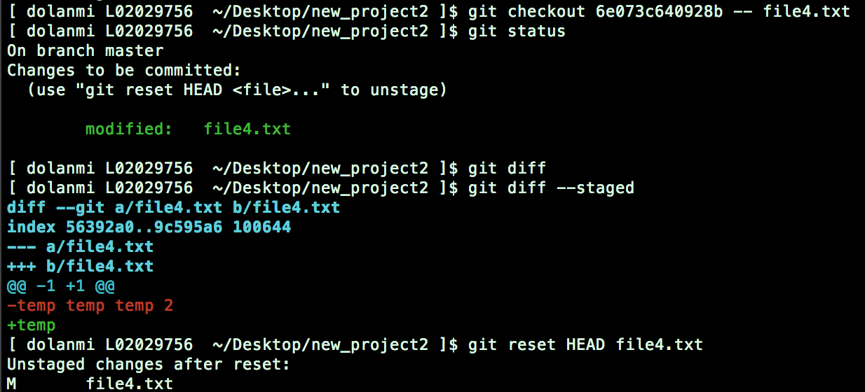
git checkout 6e073c640928b -- filename.txt
Repository
comit
Staging index
working

Slide 41
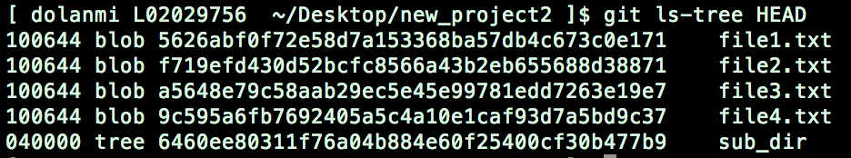
Which files are in a repo?
git ls-tree tree-ish
tree-ish – a way to reference a repo
full SHA, part SHA, HEAD, others
blob = file, tree = directory

Slide 42

Branching
allows one to try new ideas
If an idea doesn’t work, throw away the branch. Don’t have to undo many changes to master branch
If it does work, merge ideas into master branch.
There is only one working directory

Slide 43
Branching and merging example
SHA
= a commit
HEAD
master
Y4f7uiPRRo
Pu87rRi4DD
Qs2o0k64ja
i7Ewd37kL9
he8o9iKlreD
kle987yYieo
mN34i4uwQ
h4Rt5uEl9p
Ge8r67elOp
new branch
changes from new
branch merged into
master
HEAD

Slide 44
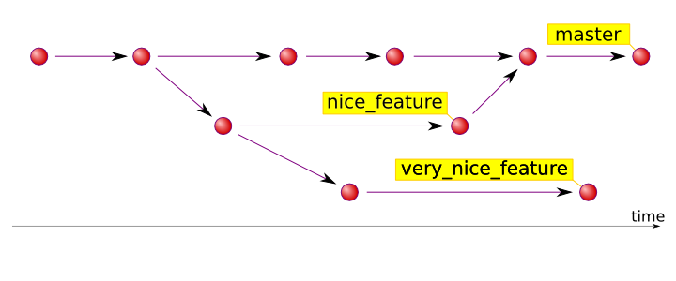
Source: http://hades.github.io/2010/01/git-your-friend-not-foe-vol-2-branches/

Slide 45
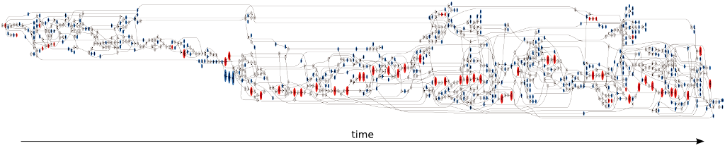
16 forks and 7 contributors to the master branch
red - commits pointed to by tags
blue - branch heads
white - merge and bifurcation commits.
Source: https://www.tablix.org/~avian/blog/archives/2014/06/vesna_drivers_git_visualization/

Slide 46

In Which Branch Am I?
git branch

Slide 47

How Do I Create A New Branch?
git branch new_branch_name
Note: At this point, both HEADs of the branches are pointing to the same
commit (that of master)

Slide 48
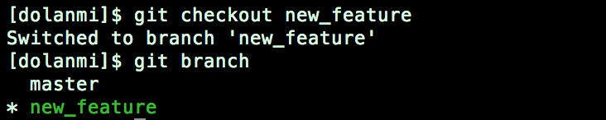
How Do I Switch To New Branch?
git checkout new_branch_name
At this point, one can switch between branches, making commits, etc. in either
branch, while the two stay separate from one another.
Note: In order to switch to another branch, your current working directory
must be clean (no conflicts, resulting in data loss).

Slide 49
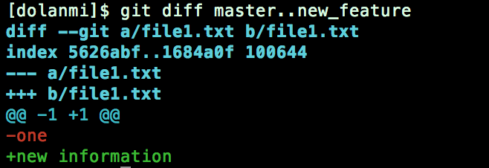
Comparing branches
git diff first_branch..second_branch

Slide 50
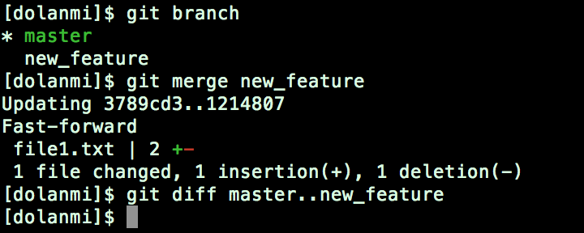
How Do I Merge A Branch?
From the branch into which you want to merge another branch….
git merge branch_to_merge
Note: Always have a clean working directory when merging

Slide 51
“fast-forward” merge occurs when HEAD of master
branch is seen when looking back
HEAD
master
Y4f7uiPRRo
Pu87rRi4DD
Qs2o0k64ja
i7Ewd37kL9
HEAD
new_branch
h4Rt5uEl9p
“recursive” merge occurs by looking back and combining
ancestors to resolve merge
HEAD
HEAD
Y4f7uiPRRo
Pu87rRi4DD
Qs2o0k64ja
i7Ewd37kL9
he8o9iKlreD
kle987yYieo
mN34i4uwQ
HEAD
h4Rt5uEl9p
Ge8r67elOp

Slide 52
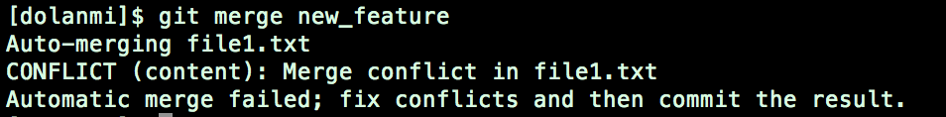
Merge Conflicts
What if there are two changes to same line in two different commits?
file1.txt
file1.txt
apple
banana
master new_feature

Slide 53
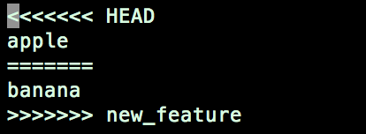
Resolving merge conflicts
Git will notate the conflict in the files!
Solutions:
Abort the merge using git merge –abort
Manually fix the conflict
Use a merge tool (there are many out there)

Slide 54
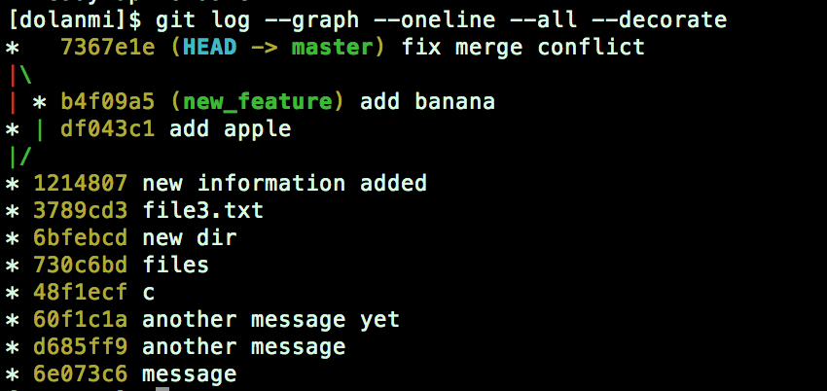
Graphing merge history
git log --graph --oneline --all --decorate

Slide 55
Tips To Reduce Merge Pain
merge often
keep commits small/focused
bring changes occurring to master into your branch frequently (“tracking”)

Slide 56
What is ?

Slide 57
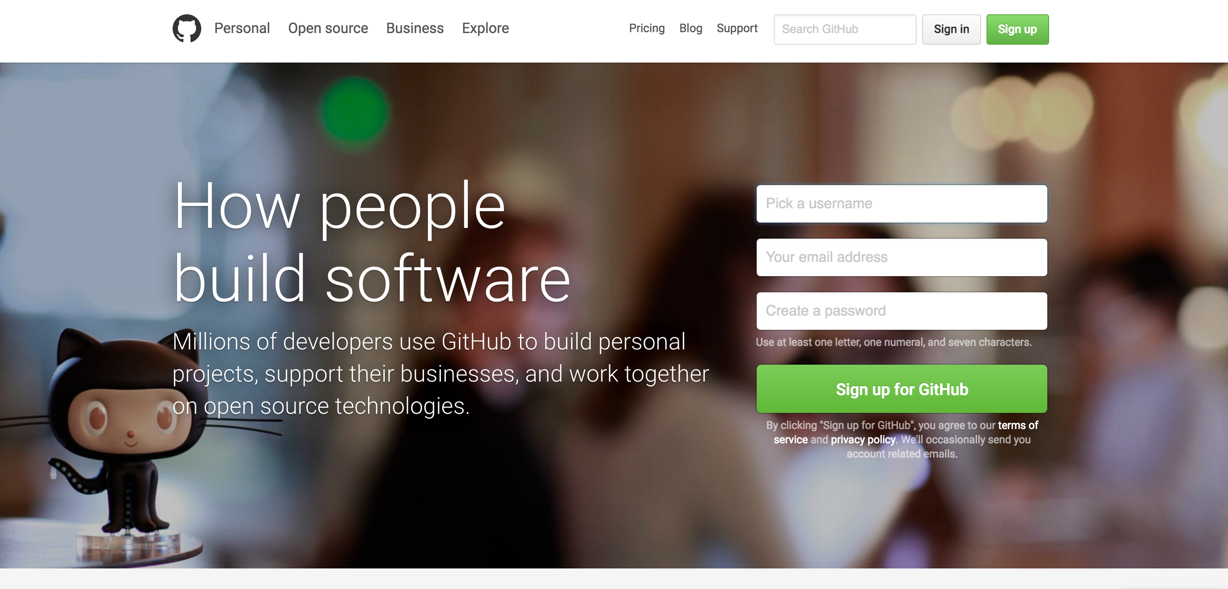

Slide 59
GitHub
a platform to host git code repositories
http://github.com
launched in 2008
most popular Git host
allows users to collaborate on projects from anywhere
GitHub makes git social!
Free to start

Slide 60
GitHub
remote
server
fork
Forked branch
master
pull request
pull/
fetch
someone
else’s master
push
Local
origin/master “branch”
push
origin/master references remote server branch and tries to stay in sync
merge
merge
repo
checkout
commit
Stage
add
Working directory

Slide 61
Important To Remember
Sometimes developers choose to place repo on GitHub as a centralized place where everyone commits changes, but it doesn’t have to be on GitHub

Slide 62
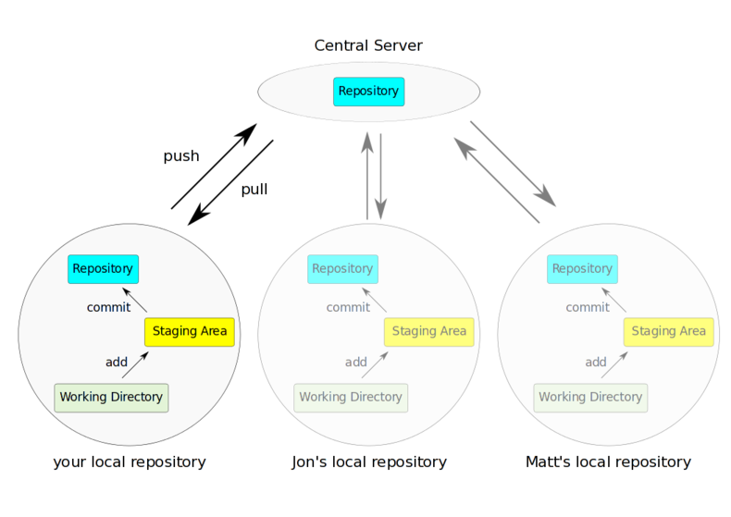
Source: http://bit.ly/1rvzjp9

Slide 63
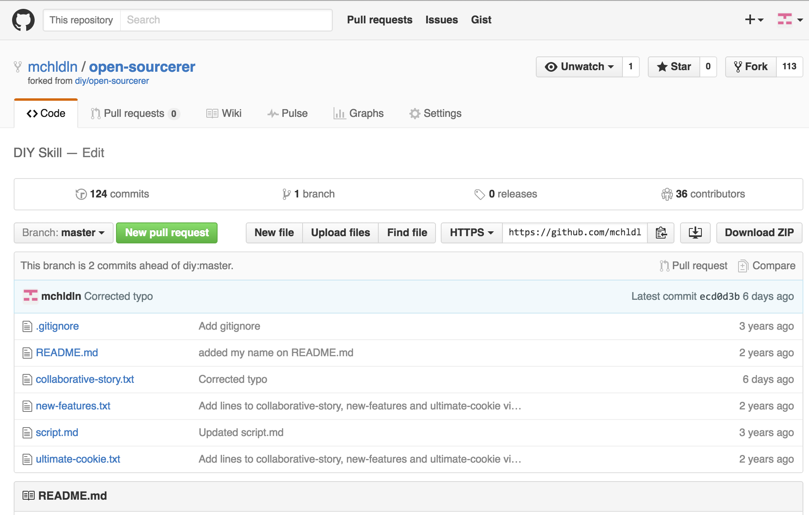

Slide 64
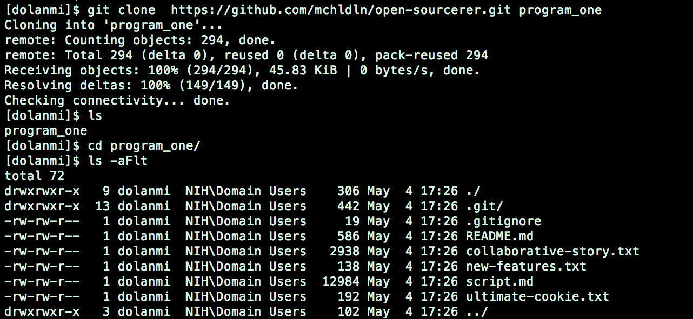
Copying (cloning) files from remote repo to local machine
git clone URL <new_dir_name>

Slide 65
GitHub
remote
server
fork
Forked branch
master
pull request
pull/
fetch
someone
else’s master
push
Local
origin/master “branch”
push
merge
clone
repo
checkout
commit
Stage
add
Working directory

Slide 66
How do I link my local repo to a remote repo?
git remote add <alias> <URL>
Note: This just establishes a connection…no files are copied/moved
Note: Yes! You may have more than one remote linked to your local
directory!
Which remotes am I linked to?
git remote

Slide 67
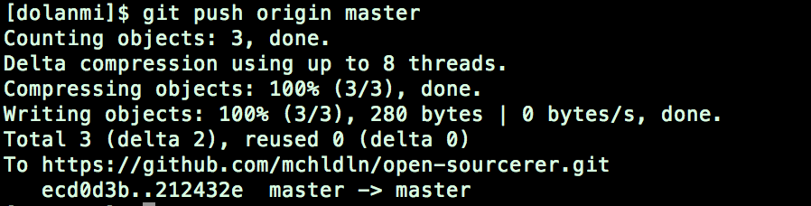
Pushing to a remote repo
git push local_branch_alias branch_name

Slide 68
Fetching from a remote repo
git fetch remote_repo_name
Fetch in no way changes a your working dir or any commits that you’ve made.
Fetch before you work
Fetch before you push
Fetch often
git merge must be done to merge fetched changes into local branch

Slide 69
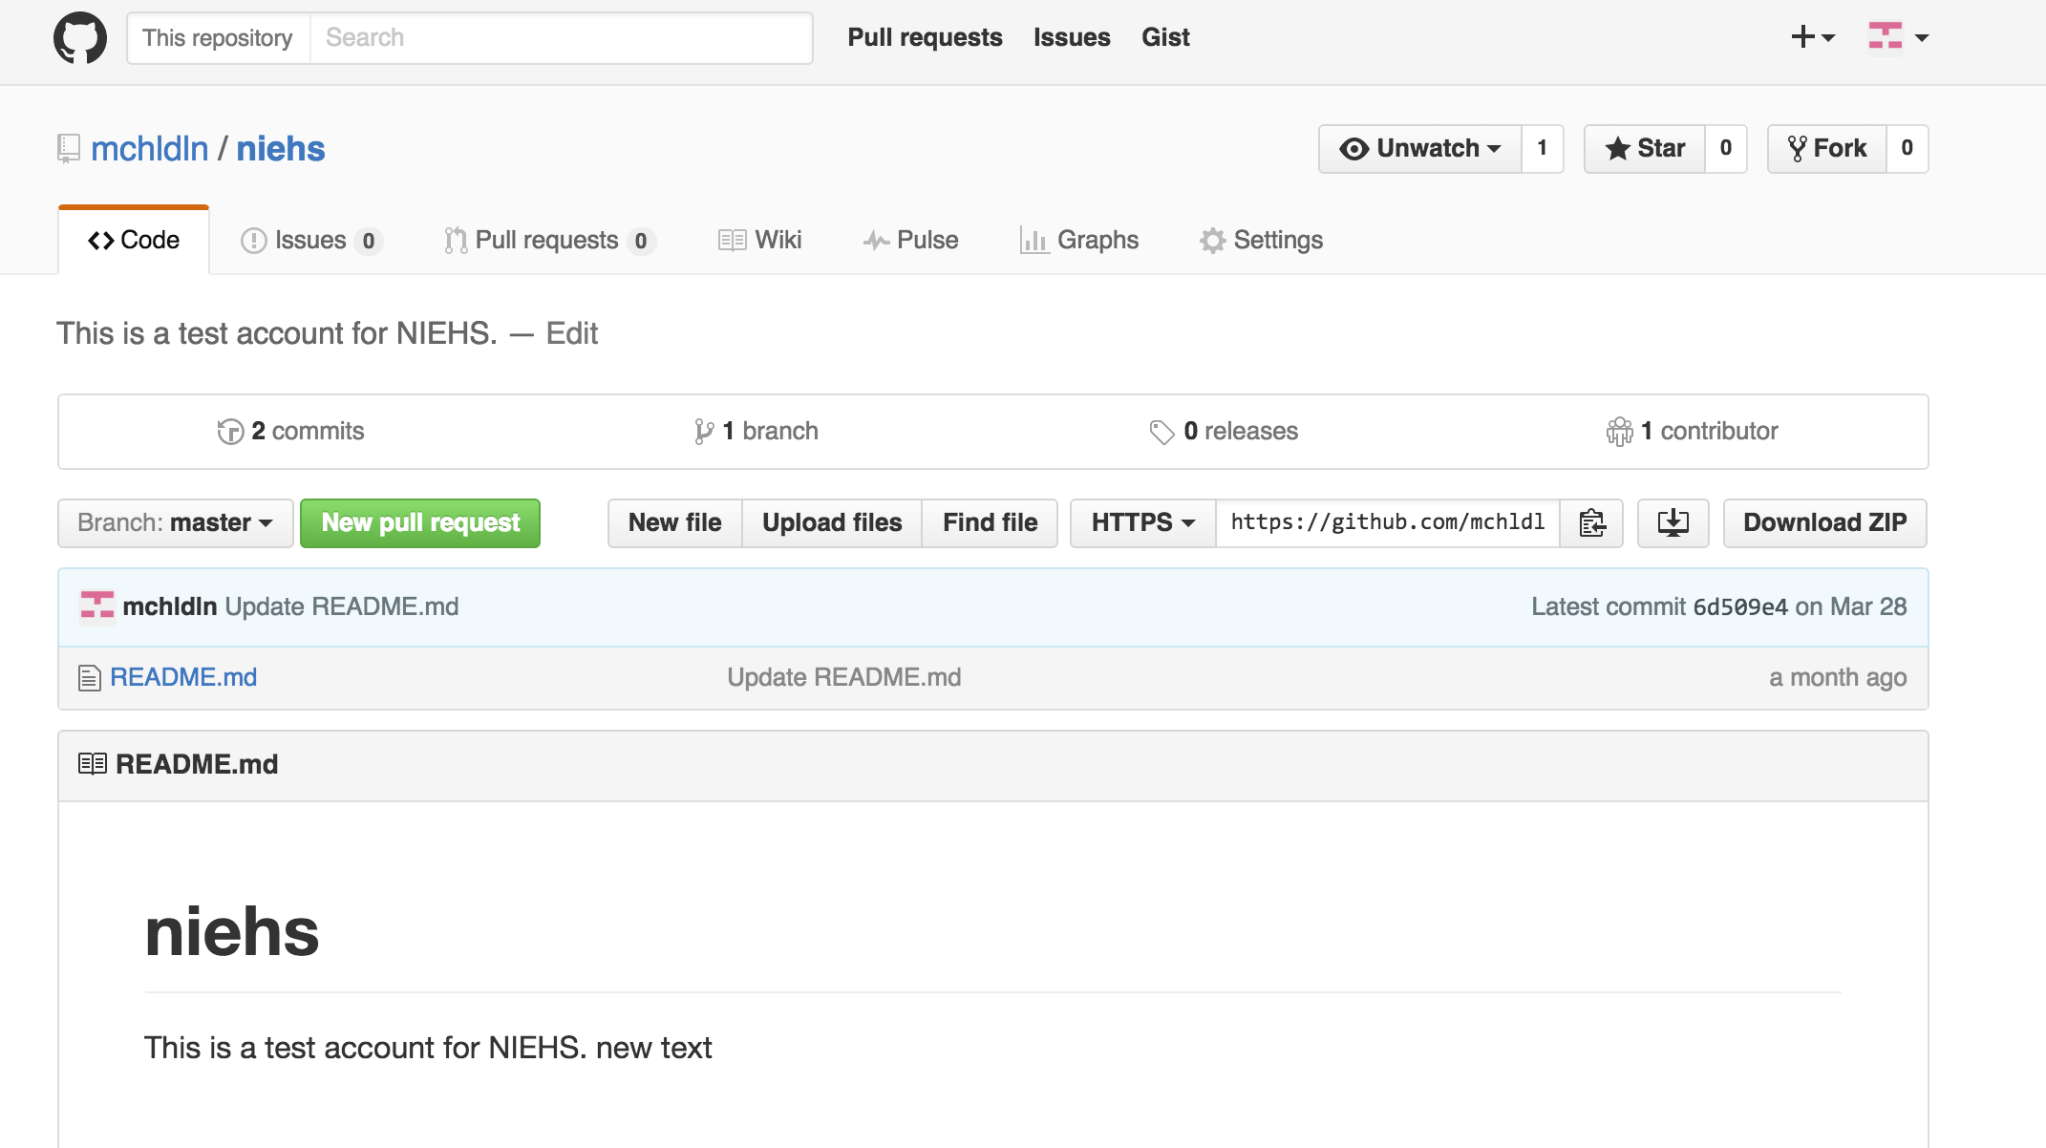
Collaborating with Git

Slide 70
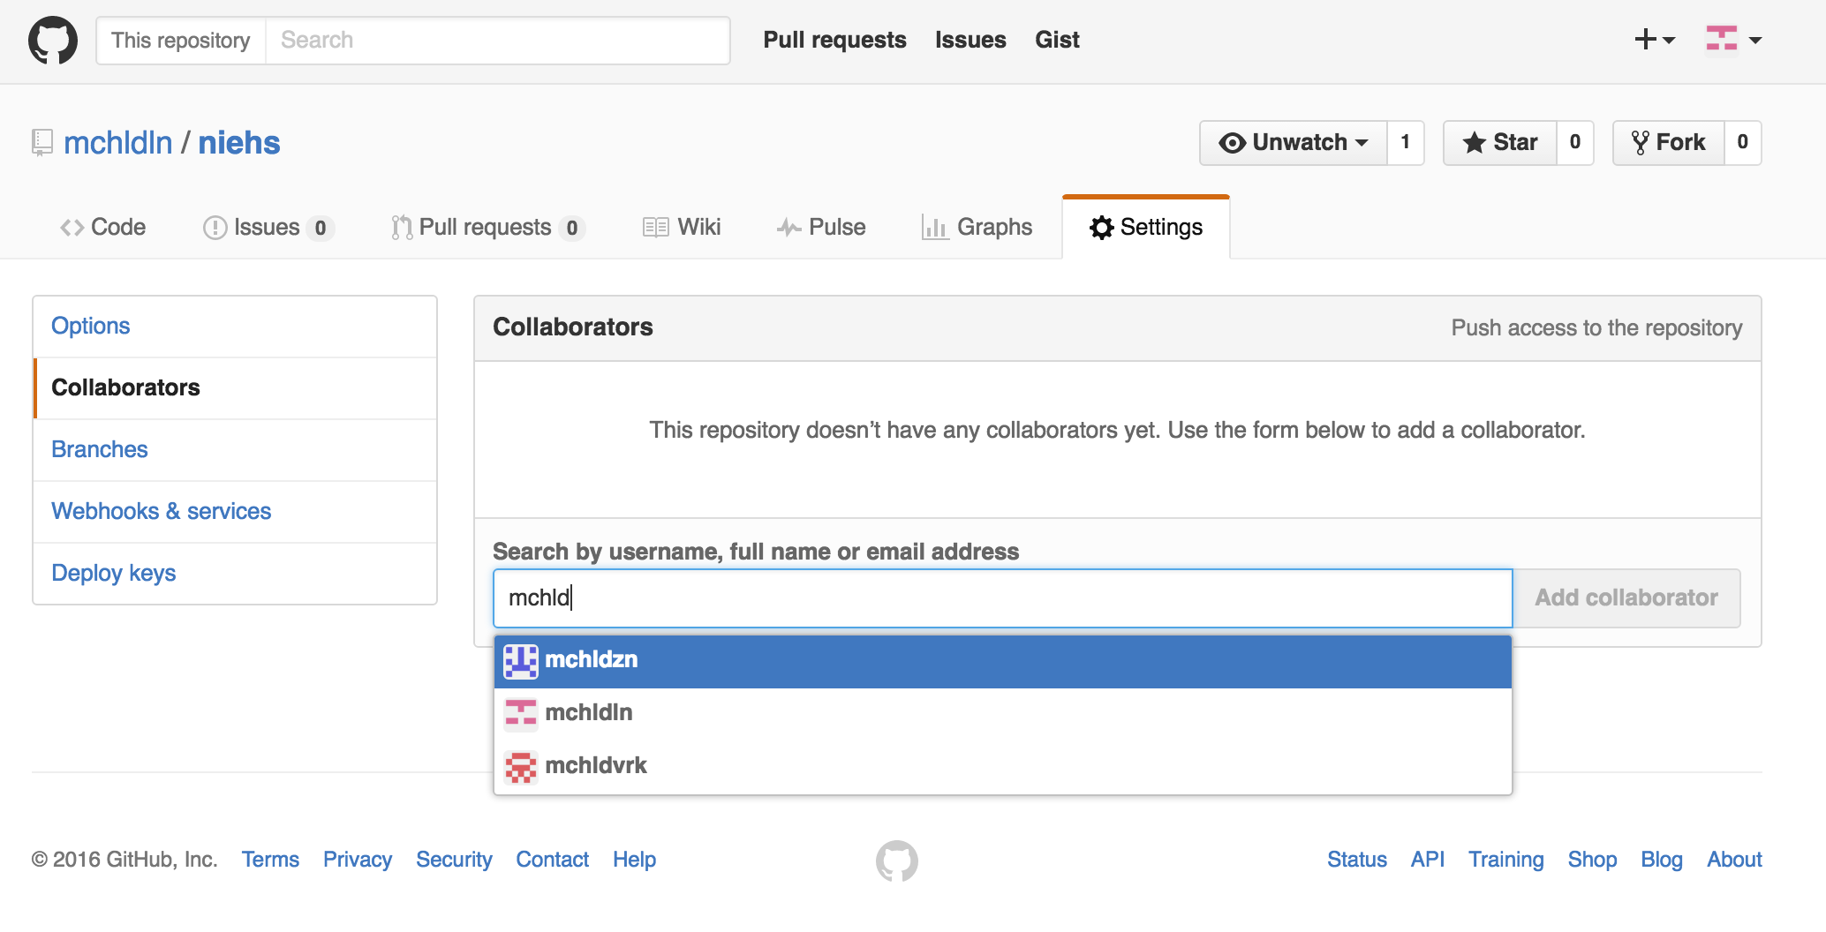
Collaborating with Git
Email sent along with link; collaborator has read/write access.
Everyone has read access
If you want write access and you haven’t been invited, “fork” the repo

Slide 71
GitHub
remote
server
fork
Forked branch
master
pull request
pull/
fetch
someone
else’s master
push
Local
origin/master “branch”
push
merge
merge
repo
checkout
commit
Stage
add
Working directory

Slide 72
New Repository in GitHub
Enterprise Account
Where to host it
License
Readme
.gitignore

Slide 73
GitHub Enterprise

Slide 74
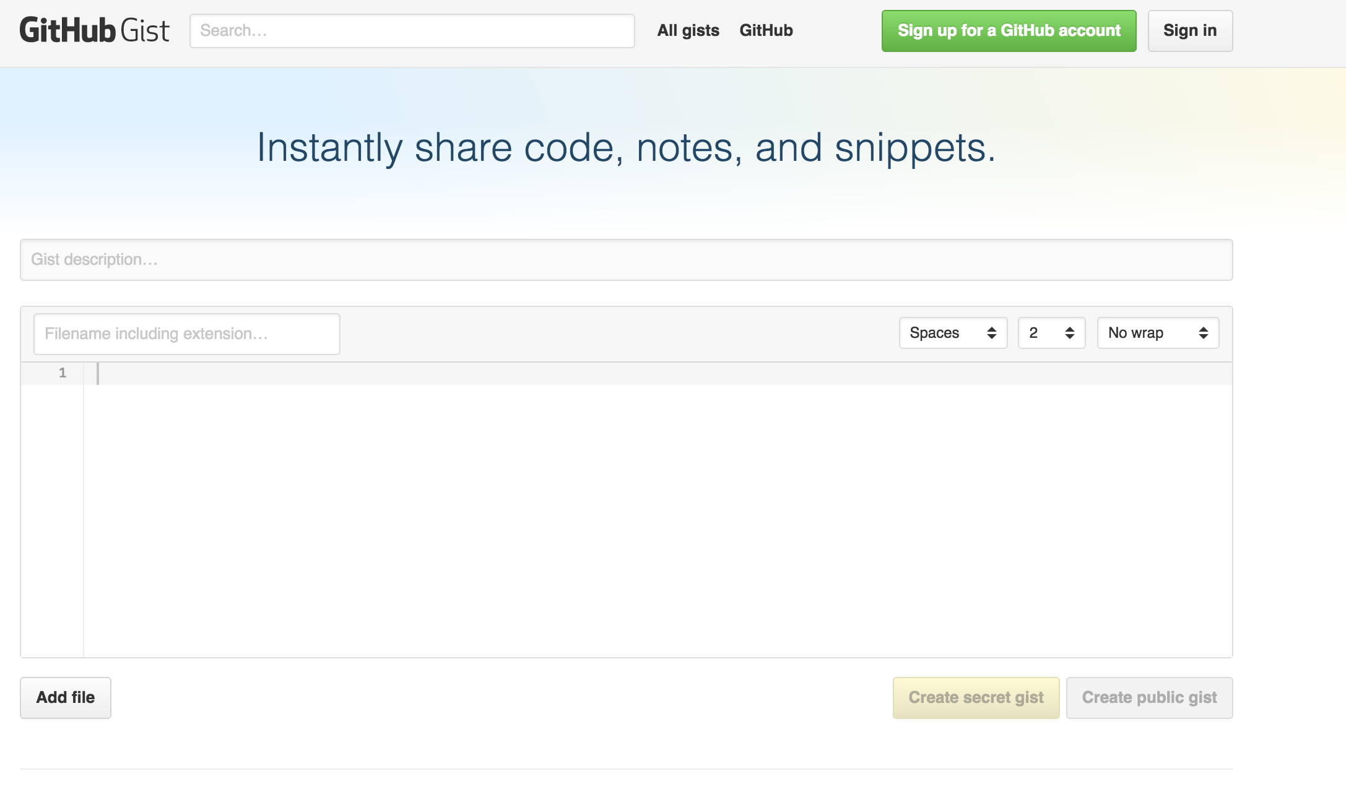
GitHub Gist
https://gist.github.com/

Slide 75
Good Resources
Git from Git:
https://git-scm.com/book/en/v2
A guided tour that walks through the fundamentals of Git:
https://githowto.com
Linus Torvalds on Git:
https://www.youtube.com/watch?v=idLyobOhtO4
Git tutorial from Atlassian:
https://www.atlassian.com/git/tutorials/
A number of easy-to-understand guides by the GitHub folks
https://guides.github.com

Slide 76
git commit -a
Allows one to add to staging index and commit at the same time
Grabs everything in working direcotry
Files not tracked or being deleted are not included

Slide 77
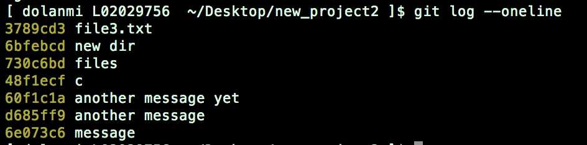
git log --oneline
gets first line and checksum of all commits in current branch

Slide 78
git diff g5iU0oPe7x
When using checksum of older commit, will
show you all changes compared to those in
your working directory

Slide 79
Renaming and deleting branches
git branch –m/--move old_name new_name
git branch –d branch_name
Note: Must not be in branch_name
Note: Must not have commits in branch_name unmerged in branch from which you are deleting
git branch –D branch_name
Note: If you are *really* sure that you want to delete branch with commits

Slide 80
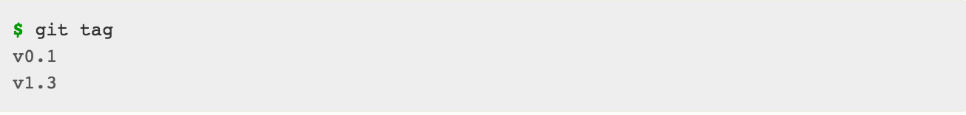
Tagging
Git has the ability to tag specific points in history as being important, such as releases versions
(v.1.0, 2.0, …)
git tag

Slide 81
Tagging
Two types of tags:
lightweight – a pointer to a specific comment –
basically a SHA stored in a file
git tag tag_name
annotated – a full object stored in the Git database – SHA, tagger name, email, date, message
and can be signed and verified with GNU
Privacy Guard (GPG)
git tag –a tag_name –m “message”

Slide 82
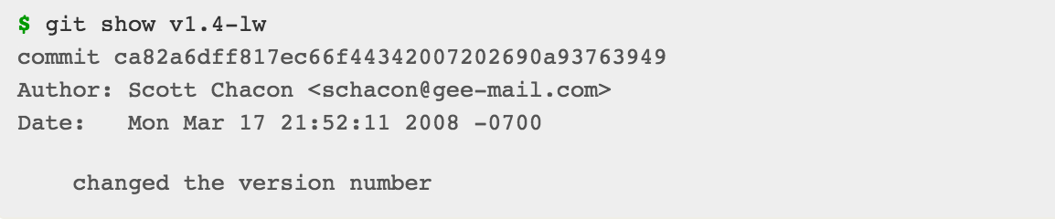
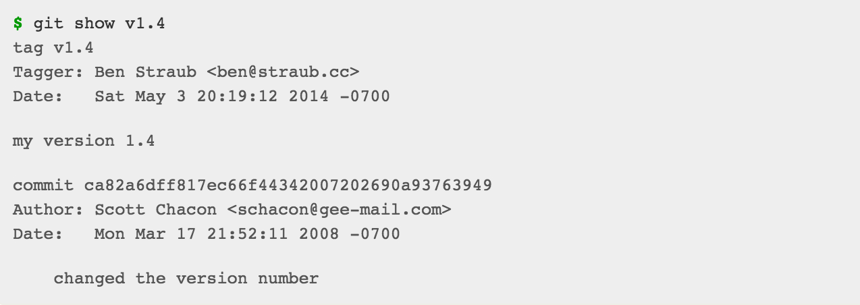
How do I see tags?
git show tag_name
Lightweight tag
Annotated tag

Slide 83
Thanks
Materials adapted from Mike Dolan’s Git and GitHub presentation

